Slide 1
Capstone Project :
Sign Language Detection
by Acinta Sofiya

Slide 2

Introduction to Sign Language Detection

Slide 3
Agenda
Problem Statement
Understading the dataset
Convolutional Neural Network
Layers of CNN
CNN Architecture
Haar Features
Model Evaluation
Model Deployment
Technology Overview
Conclusion

Slide 4
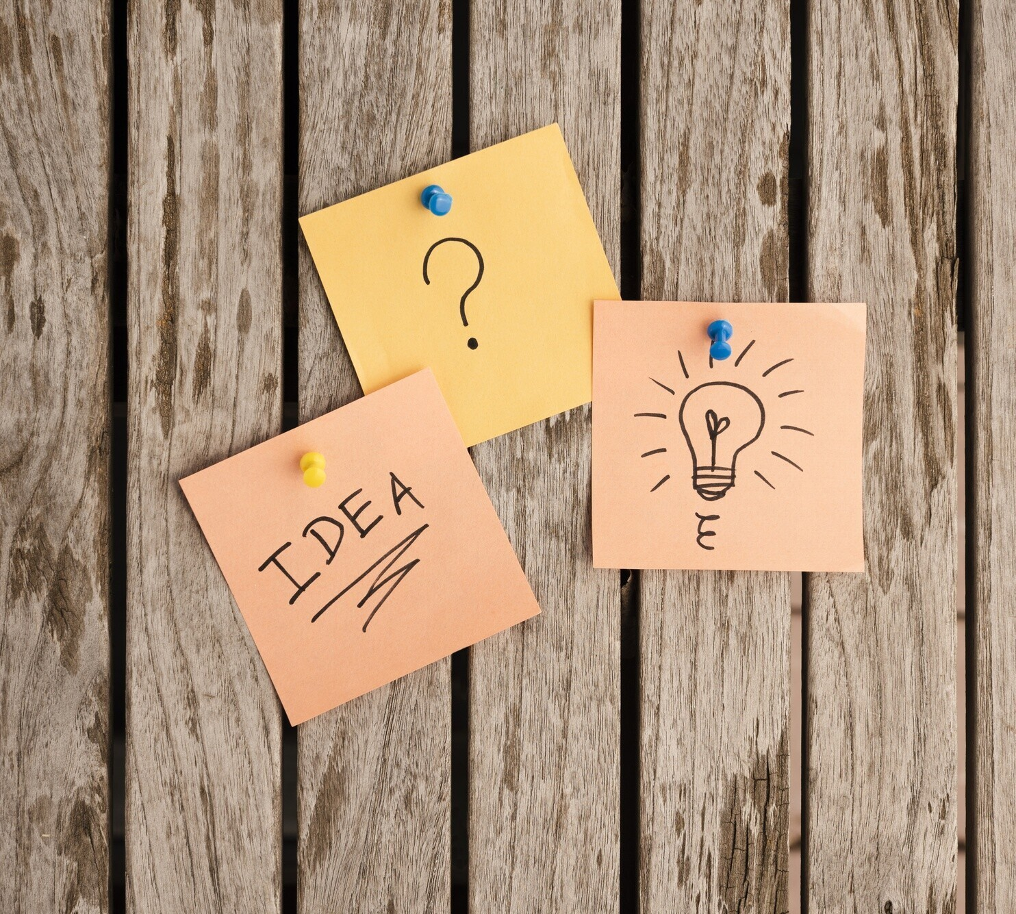
Problem Statement
The Sign Language Detection Using Images project aims to address the communication barriers faced by the deaf and hard-of-hearing community by developing a system that recognizes and interprets American Sign Language (ASL) gestures from images.
By using machine learning and image processing techniques, the project seeks to create a model that
accurately facilitating speech.
classifies a variety of ASL signs, real-time
translation into text or
This solution promotes
inclusive
communication,
empowering sign language users and enhancing social interaction between diverse communities.

Slide 5
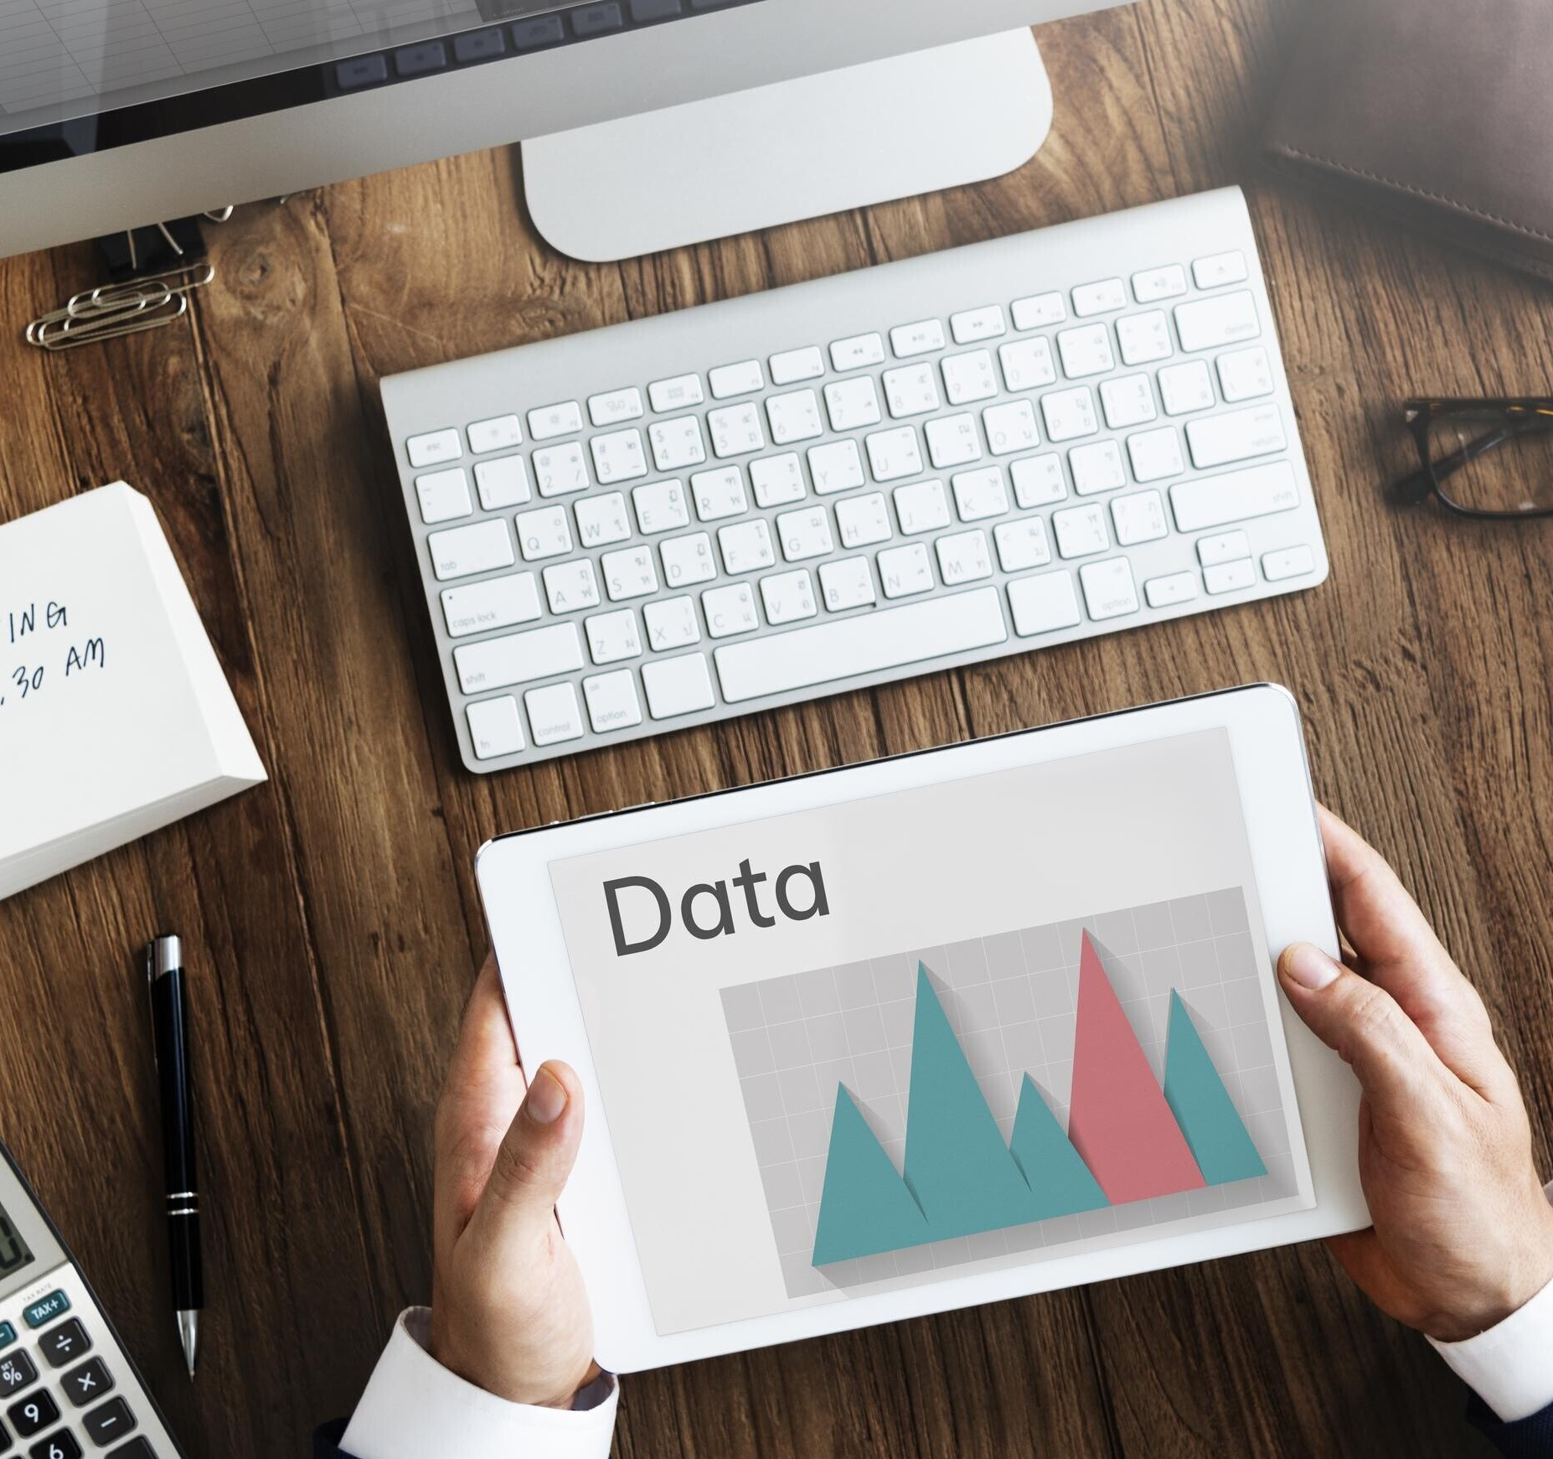
Understanding the Dataset
The dataset
for the Sign Language Detection Using
Images which
project is organized within an output_folder.zip
file,
includes two main subfolders: train and val.
The training set comprises 36 classes, representing the ASL signs for digits '0' to '9' and letters 'a' to 'z'.
Each class folder contains multiple images showcasing various hand positions and orientations for the corresponding sign, providing diverse examples for the model to learn from.
Similarly, the validation set is structured with 36 classes and includes ASL sign images for evaluation purposes. This setup allows for effective training and assessment of the model's ability to recognize and classify ASL gestures, ensuring it generalizes well to new, unseen data.4o mini

Slide 6
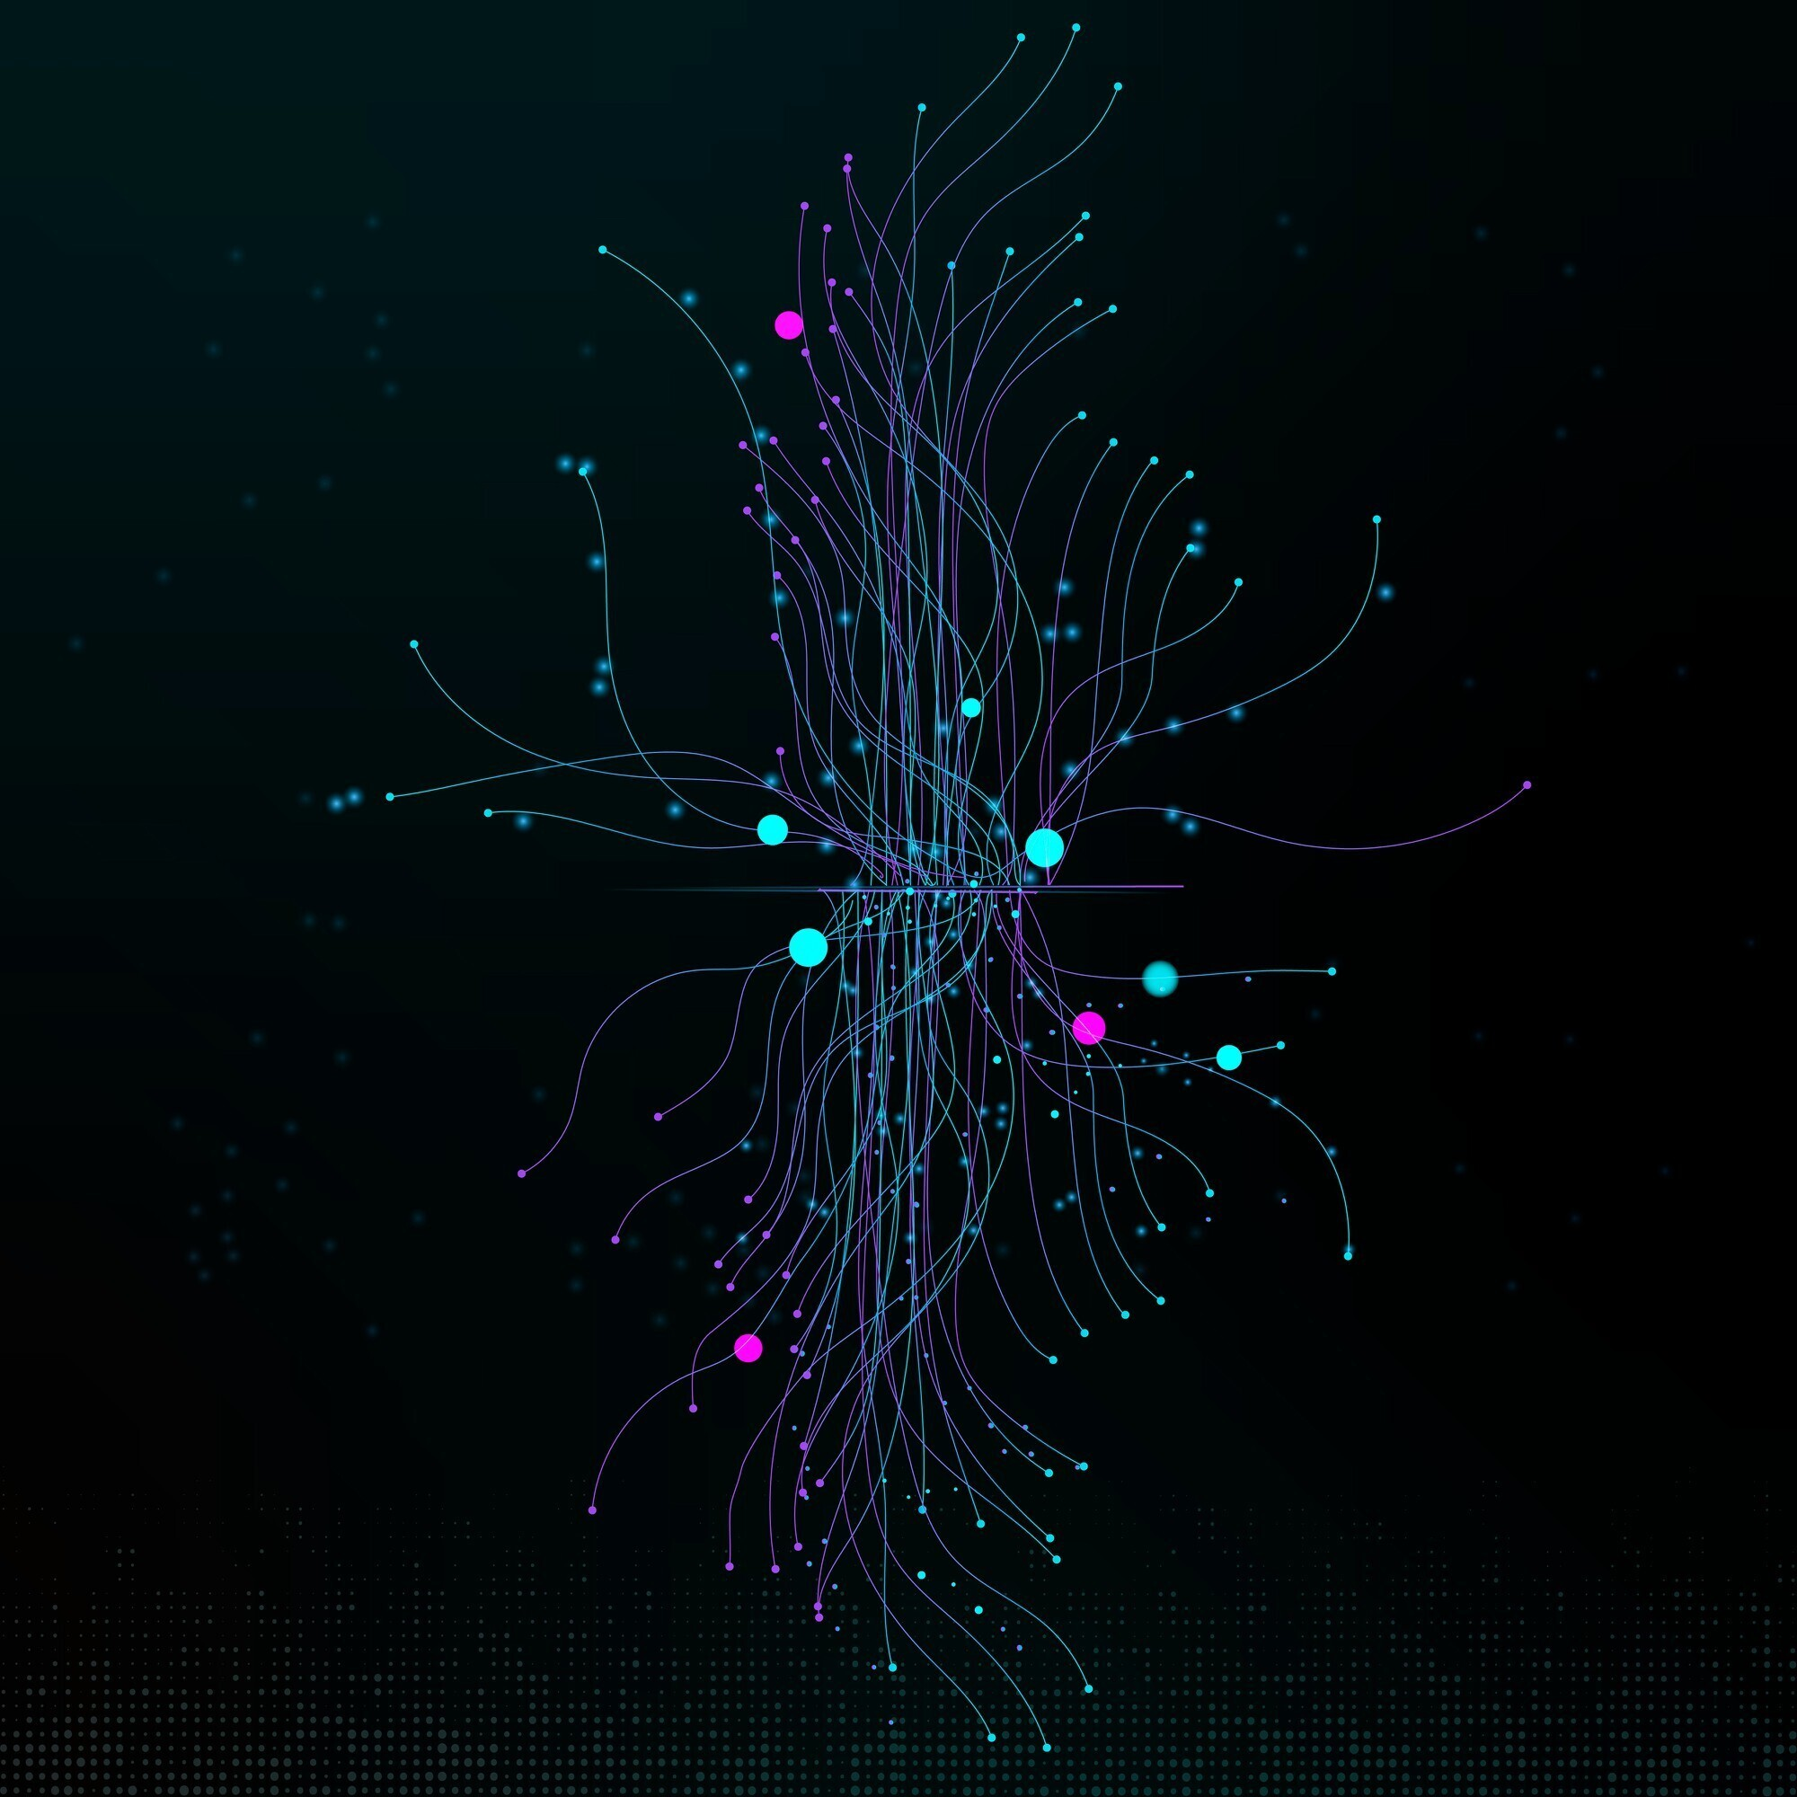
Convolutional Neural Network
A Convolutional Neural Network (CNN) is a type of deep learning model particularly effective for analyzing visual data, like images.
CNNs are designed to recognize patterns through a series of filters applied to input images, making them ideal for tasks like object detection, facial recognition, and, in this case, sign language detection.
By capturing spatial hierarchies in image data, CNNs learn to identify features like edges, shapes, and textures, progressively recognizing more complex patterns in deeper layers.

Slide 7
Layers of CNN
Input Layer
CNNs consist of several key layers, each playing a specific role. The Input Layer receives the raw image data, breaking it into color channels such as RGB.
Convolutional Layer
The Convolutional Layers then apply filters (kernels) that slide across the image to extract important features, like edges or corners,
Pooling Layer
Pooling Layers reduce the spatial dimensions, making the network more efficient and resilient to slight shifts in the image.

Slide 8
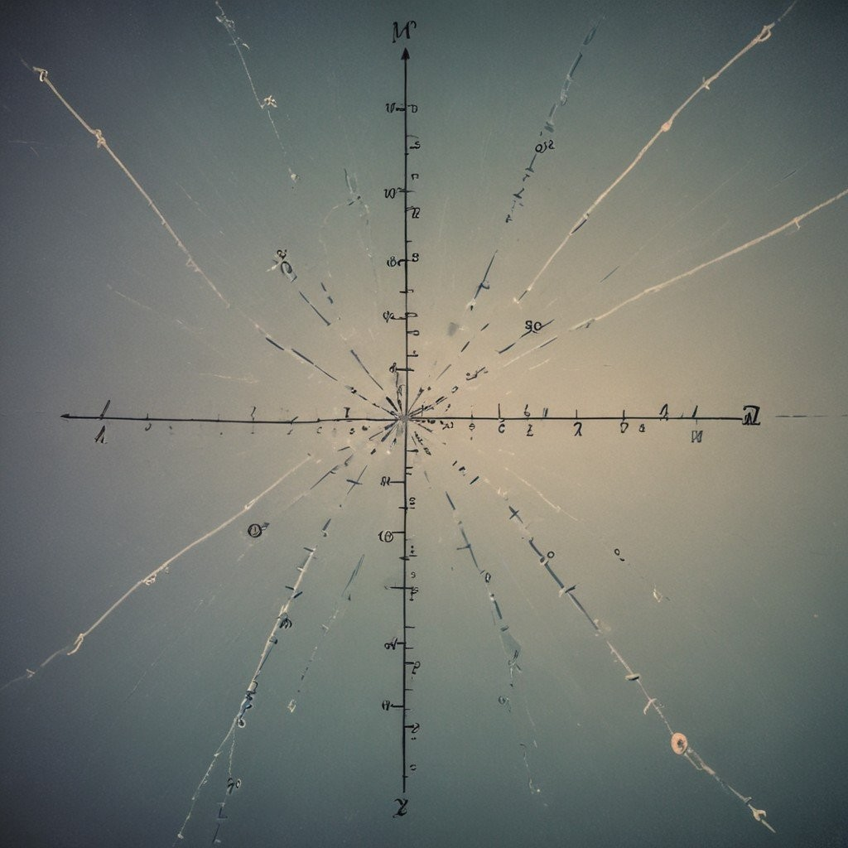
Layers of CNN
Activation Function
Activation functions introduce non-linearity to a neural network, allowing it to learn and model complex patterns.
In a Convolutional Neural Network (CNN), activation functions are applied after each convolution operation to help the network capture more complex representations of the input data.
Without activation functions, the network would simply be a linear model, limiting its ability to solve complex tasks.
In this project, ReLU (Rectified Linear Unit)is used as the activation function for the hidden layers.
For the final layer, Softmax is used as the activation function

Slide 9
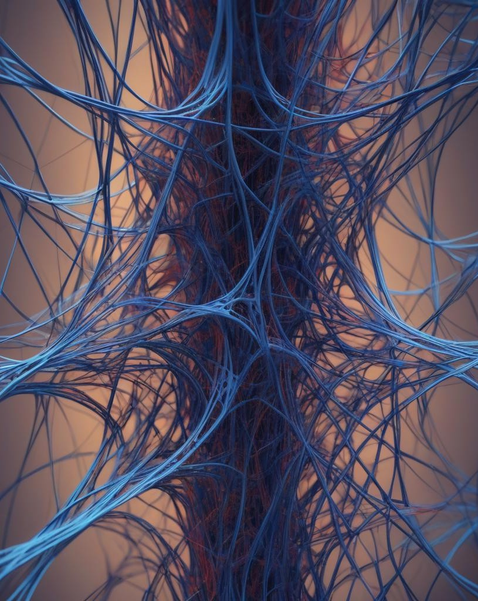
Layers of CNN
Dense Layer
In a Dense Layer, each neuron is fully connected to every neuron in the previous layer, making it one of the most "connected" layers in a neural network. This means that each neuron in a dense layer has a weight associated with every input, and the layer's output is the weighted sum of these inputs plus a bias term.
In Convolutional Neural Networks, dense layers serve as the “decision-making” layers after all the spatial features have been extracted through convolutional and pooling layers. Dense layers take the high-level features and use them to output predictions. For instance, in an image classification CNN, dense layers interpret the features (such as edges, textures, and shapes) learned from convolutions to classify the image into specific categories.

Slide 10
Layers of CNN
Dense Layer
In the Sign Language Detection project, the dense layer follows the convolutional layers, interpreting the learned patterns and making predictions about which ASL sign the hand gesture represents.
Here’s how it works in this context:
Flatten Layer: The spatial features from convolutional layers are flattened into a single vector.
Intermediate Dense Layers: These layers refine the interpretation of features through weighted combinations and non-linear activations (using ReLU).
Final Dense Layer with Softmax Activation: The last dense layer has 36 neurons (one for each ASL class, '0'-'9' and 'a'-'z'), with Softmax activation. This converts the output into a probability distribution across all classes, with the class having the highest probability as the final prediction.

Slide 11
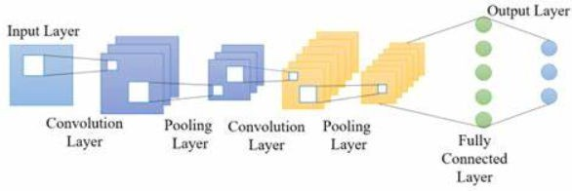
CNN Architecture

Slide 12
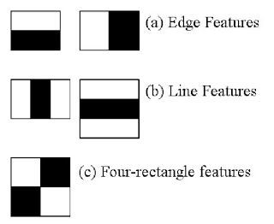
Haar Features
Haar Features are image features used primarily in object detection tasks, such as face and hand gesture detection, which can be extended to sign language recognition.
Haar features are rectangular patterns that highlight differences in pixel intensities between adjacent regions in an image.
There are several types of Haar features: \
Edge Features: Detect edges by comparing the pixel intensities of adjacent regions, such as horizontal or vertical differences.
Line Features: Capture line-like patterns by comparing three or more rectangular regions, useful for detecting lines and borders.
Four-Rectangle Features: Compare the intensity of diagonally opposite rectangles, useful for detecting more complex patterns.

Slide 13
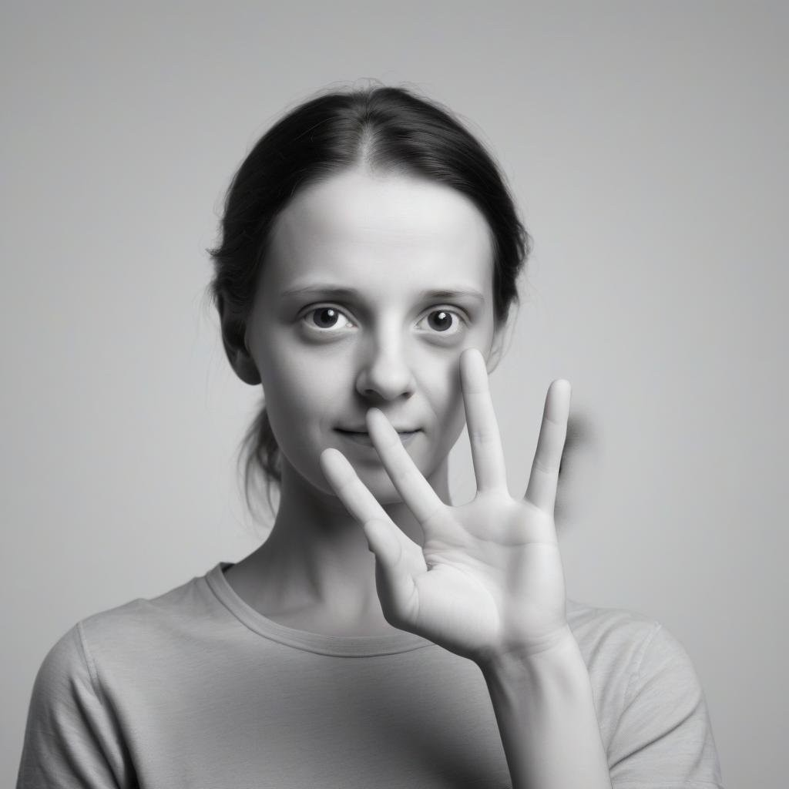
Haar Features
In sign language detection, Haar features can help identify the unique patterns formed by hand shapes, orientations, and finger positions for each sign.
Since ASL hand gestures involve distinctive shapes and finger positions, Haar features can capture these edges and textures, helping to distinguish one gesture from another.
For example:
Edge Features can help detect the boundaries of fingers or the hand's outline.
Line Features may capture the orientation or position of fingers.
Four-Rectangle Features can identify more complex interactions, like open or closed fingers in a particular orientation.

Slide 14
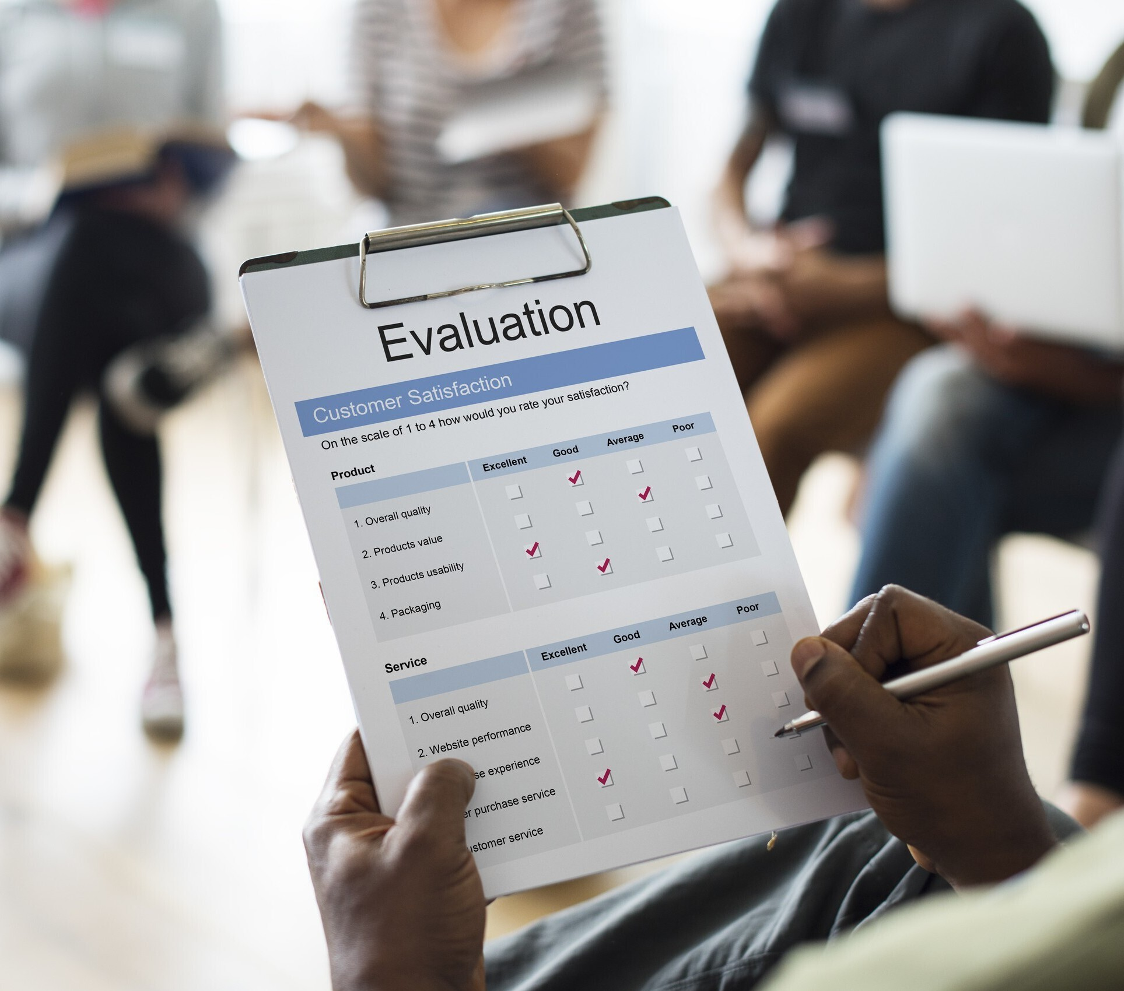
Model Evaluation
IIn this project, model evaluation is visualized by plotting the accuracy for both training and validation sets over each training epoch.
This plot tracks the model's performance improvement during training, showing trends in accuracy.
Ideally, both training and validation accuracy increase and converge.
If the training accuracy keeps improving while validation accuracy plateaus or decreases, it may indicate overfitting.
This approach provides a clear understanding of the model's generalization ability and highlights areas for potential adjustments to improve performance.

Slide 15
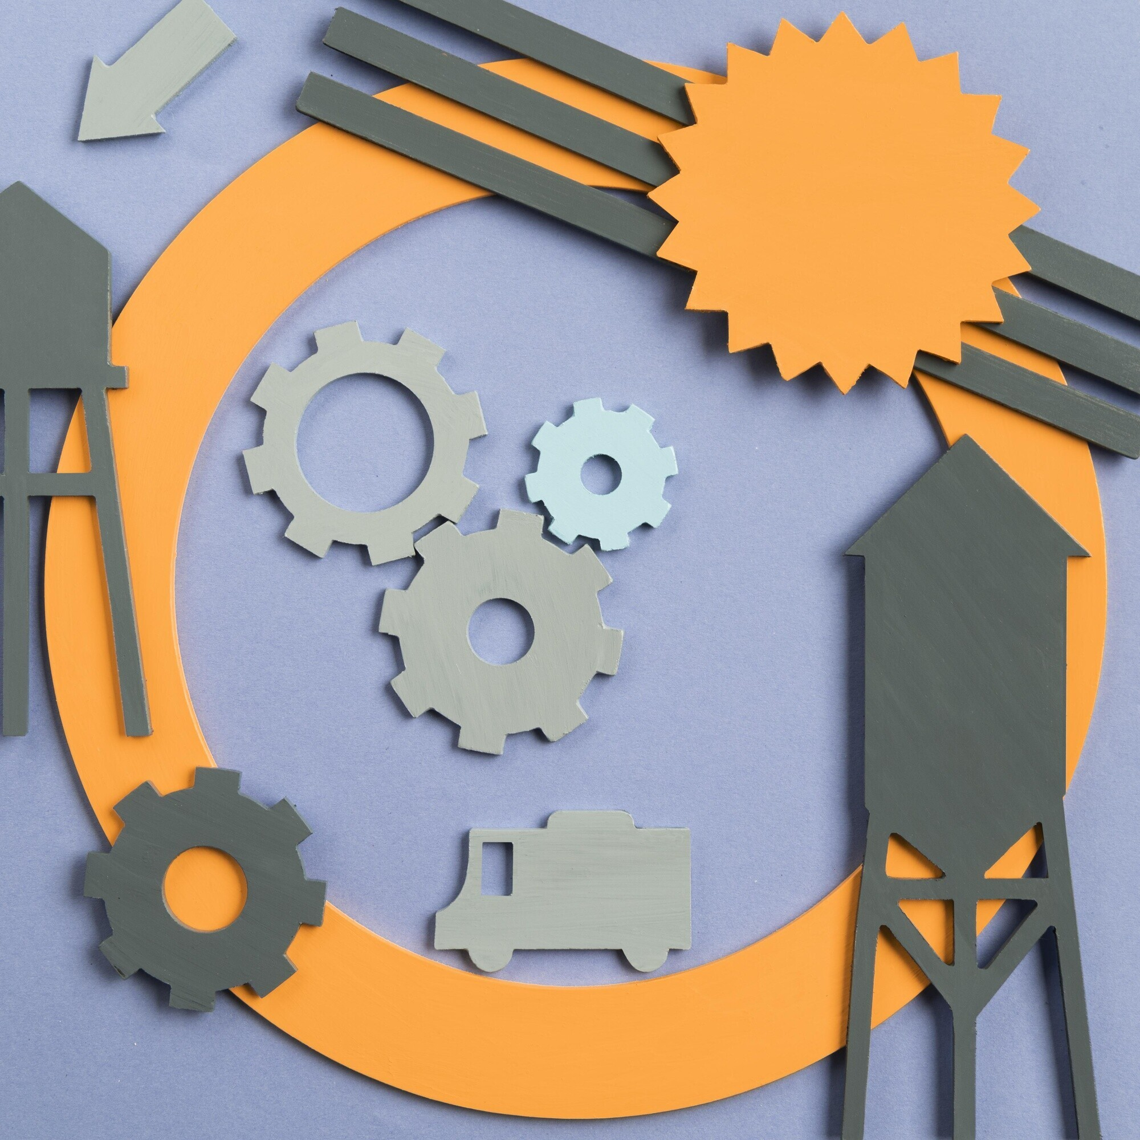
Model Deployment
The model is deployed using a Gradio app, providing an interactive interface for image classification.
When an image is uploaded as input, the app processes it through the trained model, which then classifies the image into its respective class—such as a specific hand gesture in sign language.
This deployment enables real-time predictions, allowing users to directly experience and test the model’s classification capabilities through a simple, accessible interface.

Slide 16
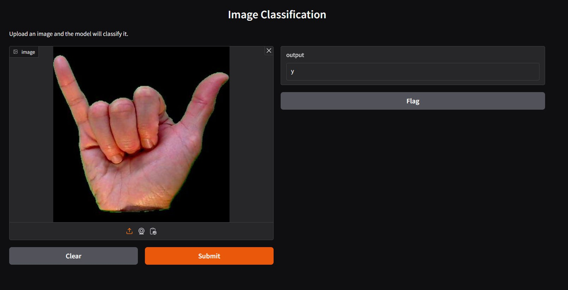
Image Classification App

Slide 17

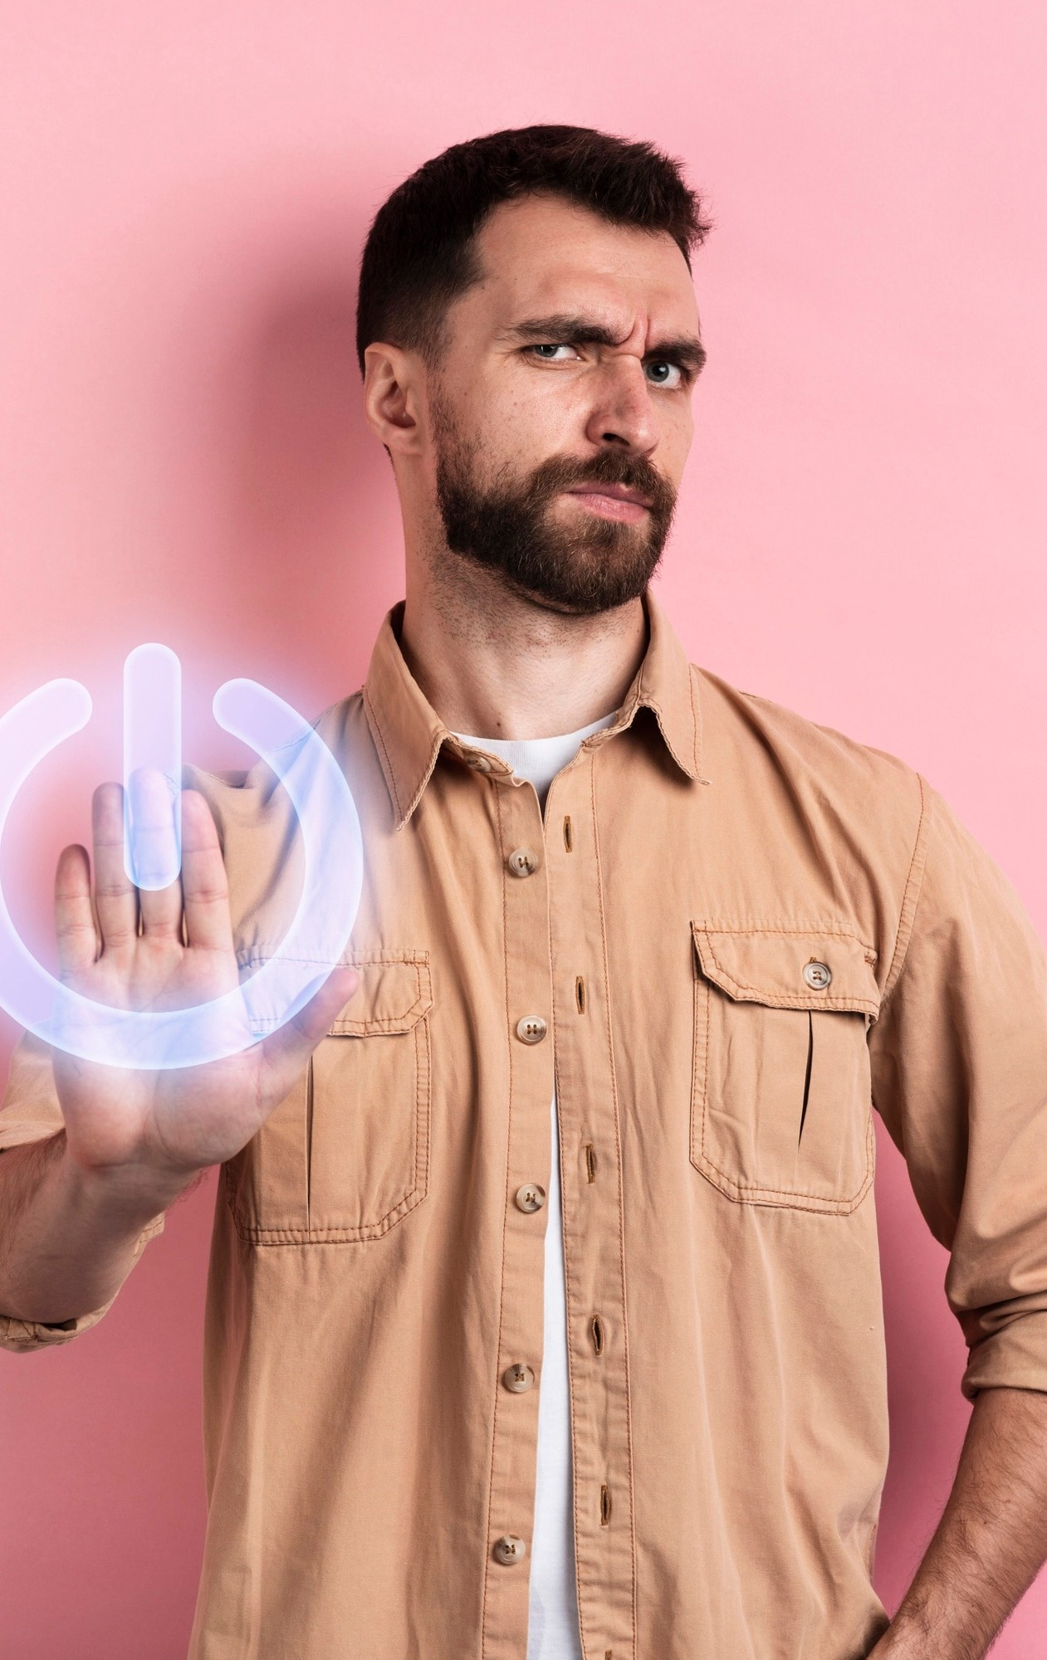


Technology Overview
The foundation of lies in
and . By
utilizing advanced algorithms, we can train
models to accurately recognize and interpret a variety of and movements, making communication more accessible for everyone.

Slide 18
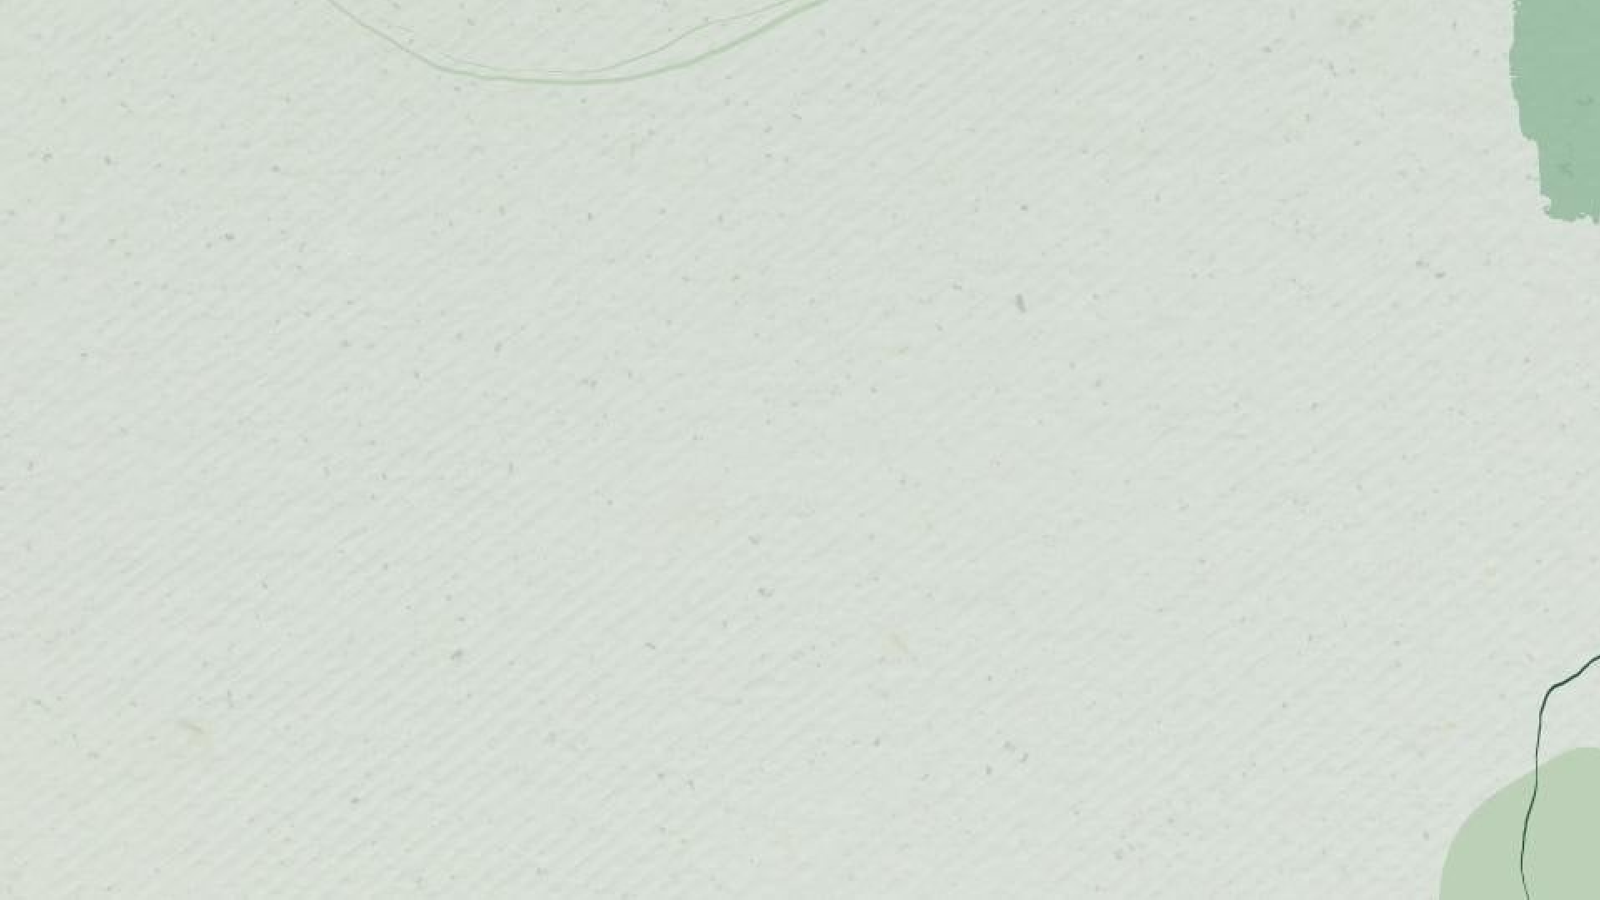

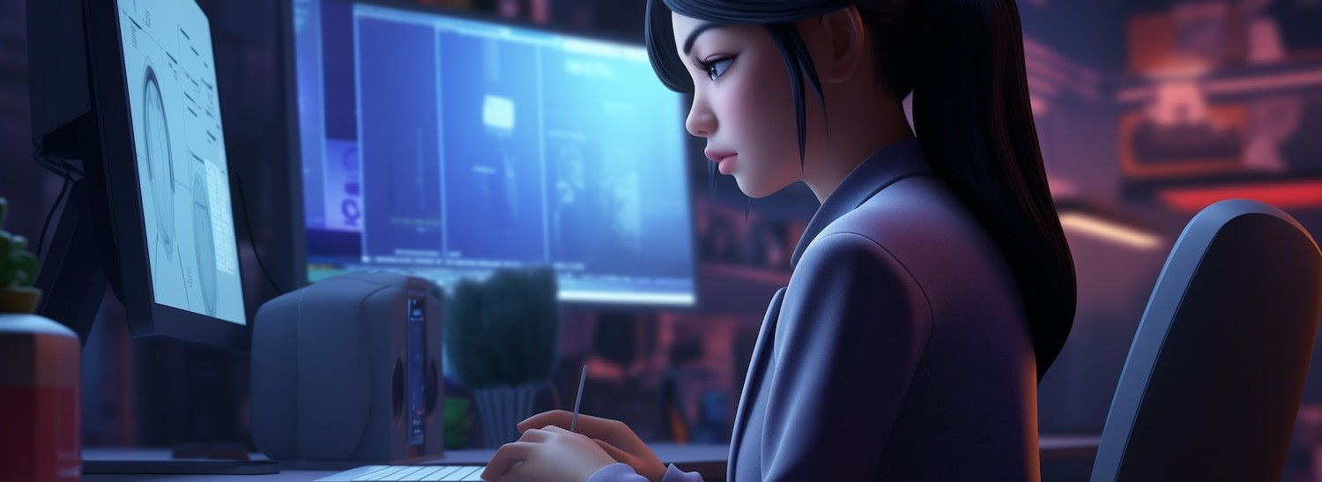
Challenges and Solutions
Implementing
in signs and the need for extensive
presents challenges such as
. Our project addresses these issues
by employing robust techniques and reﬁning algorithms to improve and adaptability across di erent sign languages.

Slide 19
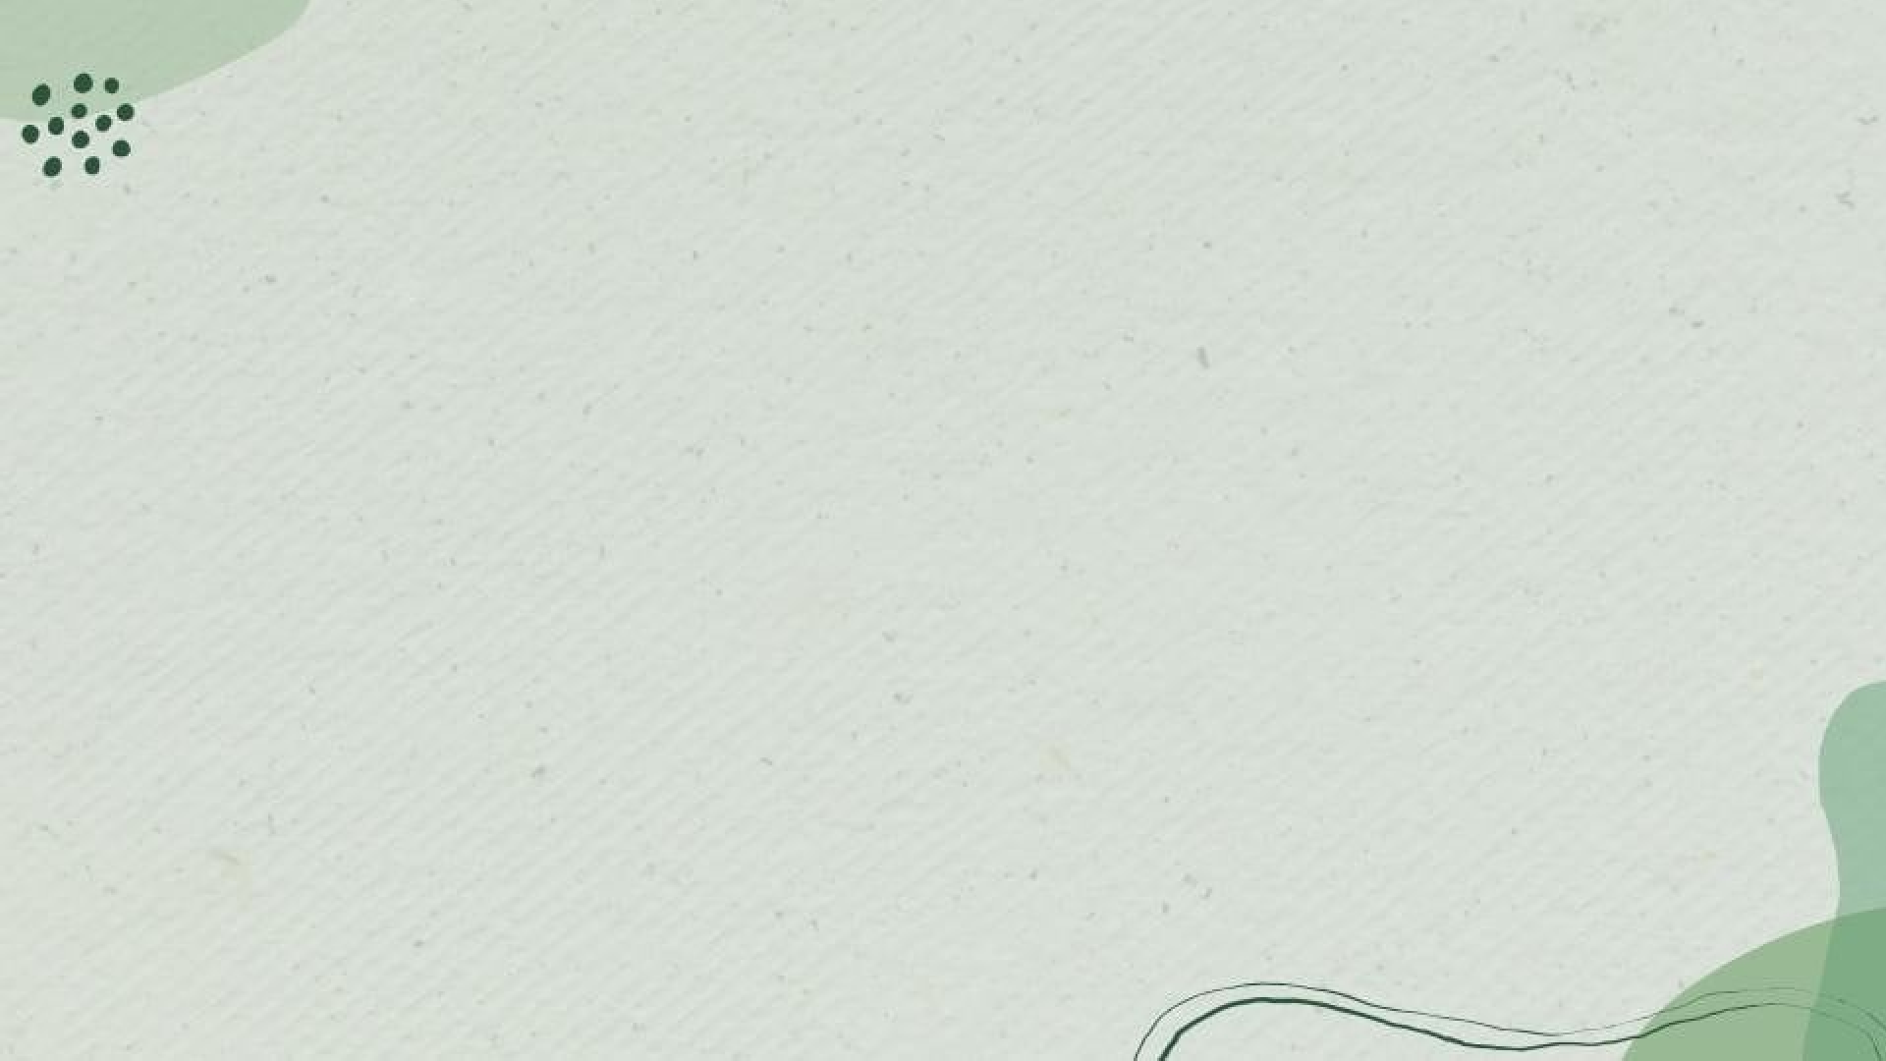

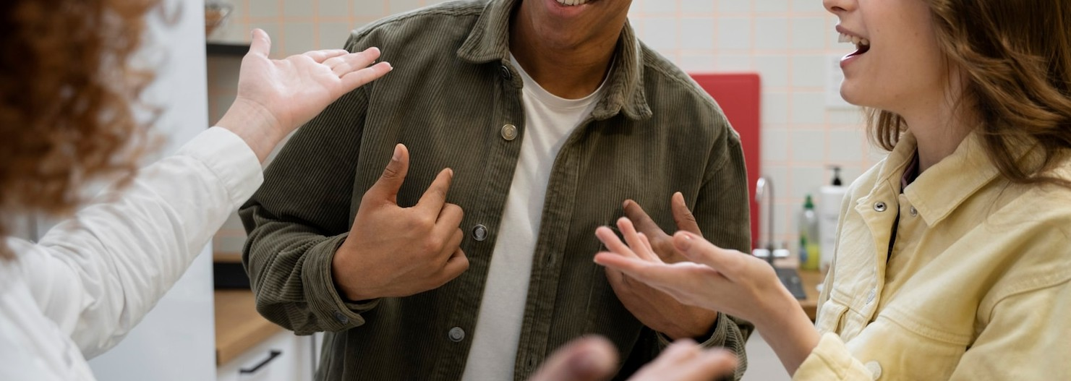
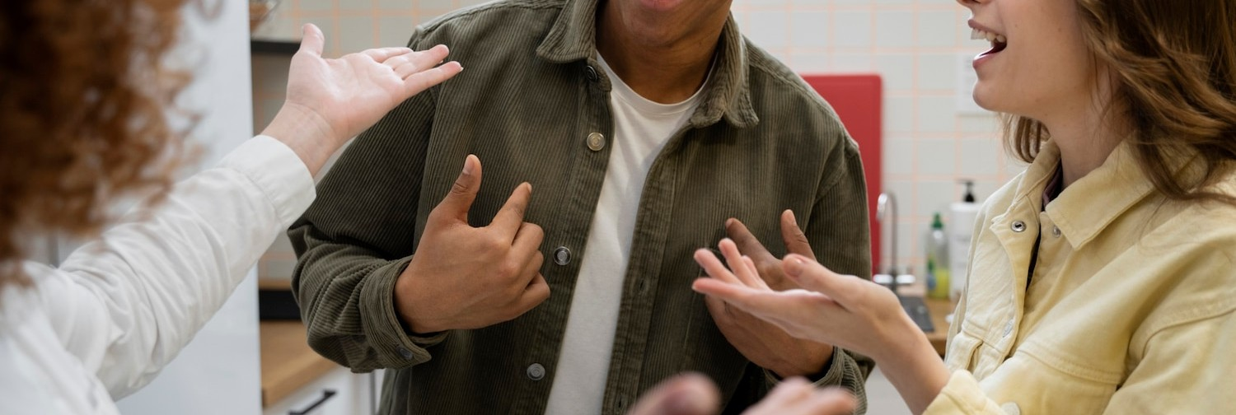
Impact on Society
The advancements in
communication for the . By promoting
have the potential to transform
, we can enhance social
interactions, education, and employment opportunities, ultimately contributing to a more
society.

Slide 20

Conclusion
This project successfully created a sign language recognition system using a CNN model trained on the ASL dataset.
The deployment through a Gradio app allows for real-time classification of hand gestures, making it an interactive tool for users.
This work demonstrates the potential of AI in enhancing communication accessibility for sign language users, with opportunities for future improvements to expand gesture recognition capabilities.

